Slide 1
OPERATIONS ON DATA STRUCTURES
Traversing It means to access each data item exactly once so that it can be processed. For example, to print the names of all the students in a class.
Searching It is used to find the location of one or more data items that satisfy the given constraint.
Such a data item may or may not be present in the given collection of data items. For example, to find the names of all the students who secured 100 marks in mathematics.
Inserting It is used to add new data items to the given list of data items. For example, to add the details of a new student who has recently joined the course.

Slide 2
Deleting It means to remove (delete) a particular data item from the given collection of data items. For example, to delete the name of a student who has left the course.
Sorting Data items can be arranged in some order like ascending order or descending order depending on the type of application. For example, arranging the names of students in a class in an alphabetical order, or calculating the top three winners by arranging the participants’ scores in descending order and then extracting the top three.
Merging Lists of two sorted data items can be combined to form a single list of sorted data items.

Slide 3
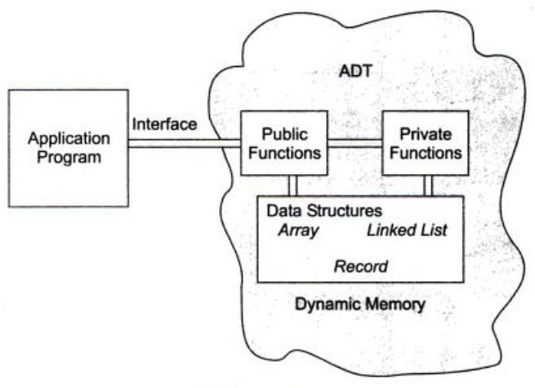
ABSTRACT DATA TYPE
An abstract data type (ADT) is the way we look at a data structure, focusing on what it does and ignoring how it does its job. For example, stacks and queues are perfect examples of an ADT. We can implement both these ADTs using an array or a linked list. This demonstrates the ‘abstract’ nature of stacks and queues.

Slide 4
DIFFERENT APPROACHES TO DESIGNING AN ALGORITHM
There are two main approaches:-
1. top-down approach
2. bottom-up approach

Slide 5
Top-down and Bottom-up Approach
The algorithms are designed using two approaches that are the top-down and bottom-up approach. In the top-down approach, the complex module is divided into submodules. On the other hand, bottom-up approach begins with elementary modules and then combine them further.

Slide 6
Algorithms are used to manipulate the data contained in data structures. When working with data structures, algorithms are used to perform operations on the stored data.
A complex algorithm is often divided into smaller units called modules. This process of dividing an algorithm into modules is called modularization. The key advantages of modularization are as
follows:
1. It makes the complex algorithm simpler to design and implement.
2. Each module can be designed independently. While designing one module, the details of other modules can be ignored, thereby enhancing clarity in design which in turn simplifies implementation, debugging, testing, documenting, and maintenance of the overall algorithm.

Slide 7
TIME AND SPACE COMPLEXITY
Algorithms are generally designed to work with an arbitrary number of inputs, so the efficiency or complexity of an algorithm is stated in terms of time and space complexity.
The time complexity of an algorithm is basically the running time of a program as a function of the input size.
The space complexity of an algorithm is the amount of computer memory that is required during the program execution as a function of the input size.

Slide 8
Worst-case running time:- This denotes the behavior of an algorithm with respect to the worst possible case of the input instance.The worst-case running time of an algorithm is an upper bound on the running time for any input. Therefore, having the knowledge of worst-case running time gives us an assurance that the algorithm will never go beyond this time limit.

Slide 9
example
Now, bringing it to programming.
You have an array of 10 positions filled with 9 numbers organized from the least valued to the most valued in this way:
10 11 30 125 150 200 300 383 777
You need to insert the number 999 and the numbers must remain organized from the minor to the major. So you need to do:
999 is greater than 10? Yes.
999 is greater than 11? Yes.
999 is greater than 30… and so on. You need to test ALL the values until you find none is greater than 999. So, you insert 999 in the last position. This is the worst case scenario in insertion sort.

Slide 10
Average-case running time :-The average-case running time of an algorithm is an estimate of the running time for an ‘average’ input. It specifies the expected behavior of the algorithm when the input is randomly drawn from a given distribution.

Slide 11
Best-case running time:- The term ‘best-case performance’ is used to analyse an algorithm under optimal conditions. For example, the best case for a simple linear search on an array occurs when the desired element is the first in the list. However, while developing and choosing an algorithm to solve a problem, we hardly base our decision on the best-case performance. It is always recommended to improve the average performance and the worst-case performance of an algorithm.

Slide 12
Time–Space Trade-off
There can be more than one algorithm to solve a particular problem. One may require less memory space, while the other may require less CPU time to execute. Thus, it is not uncommon to sacrifice one thing for the other. Hence, there exists a time–space trade-off among algorithms.
So, if space is a big constraint, then one might choose a program that takes less space at the cost of more CPU time. On the contrary, if time is a major constraint, then one might choose a program that takes minimum time to execute at the cost of more space.

Slide 13
Expressing Time and Space Complexity
The time and space complexity can be expressed using a function f(n) where n is the input size for a given instance of the problem being solved. Expressing the complexity is required when:-
1. We want to predict the rate of growth of complexity as the input size of the problem increases.
2. There are multiple algorithms that find a solution to a given problem and we need to find the algorithm that is most efficient.
The most widely used notation to express this function f(n) is the Big O notation. It provides the upper bound for the complexity.

Slide 14
Rate of growth
M-Algorithm
N-input size
Complexity- f(n)
With the values like log n, n,n log n, n

Slide 15
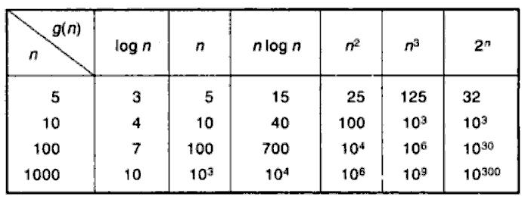
Rate of Growth:
Suppose M is an algorithm, and suppose n is the size of its input. The complexity f(n) of
M increase as n increases. It is usually that rate of increase we want to know.

Slide 16
ASSYMPTOTIC NOTATIONS( for complexity)
1. Big O notation:-
Suppose f(n) and g(n) are functions defined on the positive integers with the property that f(n) is bounded by some multiple of g(n) for almost all n. That is suppose there exist a positive integer n0 and a positive integer M such that, for all n>n0, we have
|f(n)|<=M|g(n)|
then,
f(n)=O(g(n))
It means that for large amounts of data, f(n) will grow no more than a constant factor than g(n). Hence, g provides an upper bound.

Slide 17
For any polynomial P(n) of degree m,
8n3-23n2+52n+187 =O(n3)
Also we can write,
F(n)=h(n)+ O (g(n))
or
F(n)-h(n)=O(g(n))

Slide 18
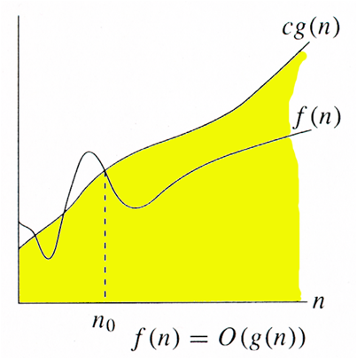
Examples of f(n) and g(n)
g(n) f(n) = O(g(n))
2n3 + 1 O(n3)
3n2 + 5 O(n2)
2n3 + 3n2 + 5n – 10 O(n3)
OMEGA NOTATION (Ω)
The Omega notation provides a tight lower bound for f(n).
F(n)=g(n),iff there exixts a positive integer n0 and a positive number M such that
|f(n)|>=|M(g(n))|, for all n>=n0

Slide 19
(i)F(n)=18n+10
ie f(n)>18n for n>=1
so f(n)= Ω g(n)
(ii) F(n)=18n2+10n+15
F(n)>18n2
So f(n)= Ωn2

Slide 21

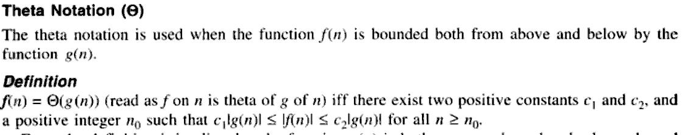


Slide 22
Categories of Algorithms
According to the Big O notation, we have five different categories of algorithms:
1. Constant time algorithm: running time complexity given as O(1)
2. Linear time algorithm: running time complexity given as O(n)
3. Logarithmic time algorithm: running time complexity given as O(log n)
4. Polynomial time algorithm: running time complexity given as O(n^k) where k > 1
5. Exponential time algorithm: running time complexity given as O(2^n)

Slide 23
Multiple-choice Questions
1. Which data structure is defined as a collection of
similar data elements?
(a) Arrays (b) Linked lists
(c) Trees (d) Graphs
2. The data structure used in hierarchical data model
is
(a) Array (b) Linked list
(c) Tree (d) Graph
3. In a stack, insertion is done at
(a) Top (b) Front
(c) Rear (d) Mid
4. The position in a queue from which an element is
deleted is called as
(a) Top (b) Front
(c) Rear (d) Mid
5. Which data structure has fixed size?
(a) Arrays (b) Linked lists
(c) Trees (d) Graphs

Slide 24
6. If TOP = MAX–1, then that the stack is
(a) Empty (b) Full
(c) Contains some data (d) None of these
7. Which among the following is a LIFO data
structure?
(a) Stacks (b) Linked lists
(c) Queues (d) Graphs
8. Which data structure is used to represent complex
relationships between the nodes?
(a) Arrays (b) Linked lists
(c) Trees (d) Graphs
9. Examples of linear data structures include
(a) Arrays (b) Stacks
(c) Queues (d) All of these
10. The running time complexity of a linear time
algorithm is given as
(a) O(1) (b) O(n)
(c) O(n log n) (d) O(n2)

